Slide 1
Course title : PJT – Product development project COURSE CODE : BCSE394J

Slide 2
SCHOOL SECURITY SYSTEM USING FACIAL RECOGNITION

Slide 3
Team Members
Krish Goel (21BCE6097)
Meghna Das (21BCE1422)
Aastha Kumar (21BCE5067)
Godavari Tanmayi (21BCE5976)
T Suraj Kumar (21BCE5922)

Slide 4
Project Guides
Faculty Supervisor – Dr. Suganya R.
Faculty Co-Supervisor – Dr. Subbulakshmi T.

Slide 5
Abstract
The project aims at introducing a Facial Recognition School Security System as one solution to improve security while speeding up administrative processes in educational institutions. The need for such a system emanates from concerns over the safety of schools as well as inadequacies inherent in conventional attendance and access control methods. Inadequate methods can be manual or rely on an older technology that leads to inefficiencies, inaccuracies and breaches of security. This proposed solution exploits contemporary Artificial Intelligence algorithms and Computer Vision techniques to facilitate the reliable identification and validation of entrants thereby providing contactless approach during pandemic times in compliance with the COVID-19 safety protocols. At this period of COVID-19 it also acts as an avenue where physical touchpoints are reduced with consideration to social distancing measures. Our method is novel in the fact that it only detects and recognizes human faces as opposed to general object detection systems. We use Local Binary Pattern Histograms (LBPHs) for face recognition and Haar Cascades for face detection. The Haar Cascade algorithm employs simple rectangular features to detect faces, using a cascade of weak classifiers to achieve high detection rates. The LBPH algorithm captures local texture patterns of facial features, calculating LBP values for each pixel. Our project demonstrates variable performance across different classes, with precision ranging from 0.50 to 1.00, recall from 0.33 to 1.00, and F1 scores from 0.33 to 0.94, while achieving an overall accuracy of 0.75, indicating robust performance in certain scenarios but room for improvement in others.

Slide 6
Introduction
In recent years, ensuring the security of educational institutions has become a paramount concern, with schools seeking innovative solutions to protect students and staff. Traditional security measures, such as ID cards and manual attendance, often fall short in providing real-time and efficient security. To address these challenges, our project proposes the development of a School Security System using Facial Recognition technology. This system aims to enhance the security infrastructure of schools by leveraging advanced facial recognition algorithms to monitor and control access to the premises. Facial Recognition technology has gained widespread recognition for its applications in various sectors, including law enforcement, banking, and personal devices. Its accuracy and efficiency in identifying individuals make it an ideal choice for school security systems. By integrating this technology, we aim to create a seamless, automated system that can recognize and verify individuals in real-time, thereby preventing unauthorized access and ensuring the safety of the school environment.

Slide 7
Problem Statement
Educational institutions face numerous challenges in trying to maintain a safe environment and effective administrative procedures. Regularly, attendance and identification tracking methods are manual, tedious, prone to errors and cannot offer real-time monitoring. Additionally, conventional access control systems may be vulnerable to hacking or security breaches. For that reason, there is need for an automated solution that will effectively address these issues with respect to school security at large.

Slide 8
Target Audience
School Administrators
Staff
Students
School Security Personnel

Slide 9
Objectives
Develop a comprehensive school security system incorporating facial recognition.
Improve monitoring and automation of various tasks.
Streamline attendance tracking.
Strengthen security measures across the organization.
Reduce paperwork and clerical tasks.
Provide educational organizations with a reliable and effective tool for their activities.

Slide 10
Functionalities of the Model
Facial Recognition
Access Control
Database Management
User Interface
Attendance Tracking
Data Analytics
Integration with Existing Systems
Scalability and Customization

Slide 11
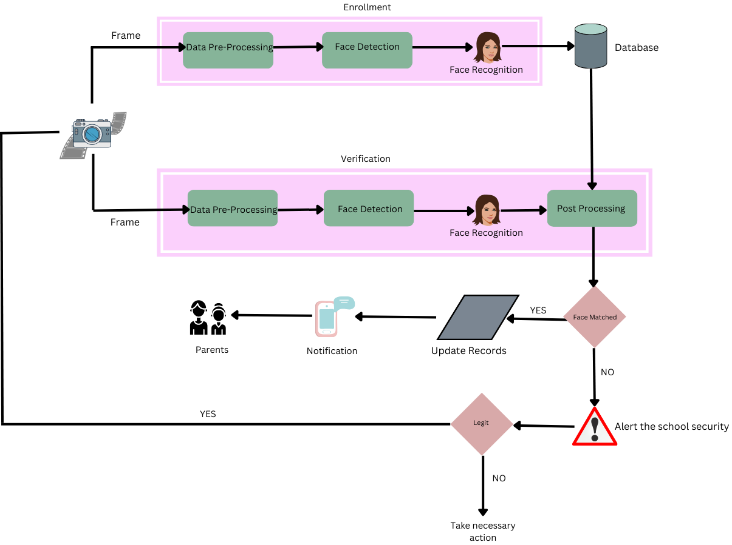
Flow Diagram

Slide 12
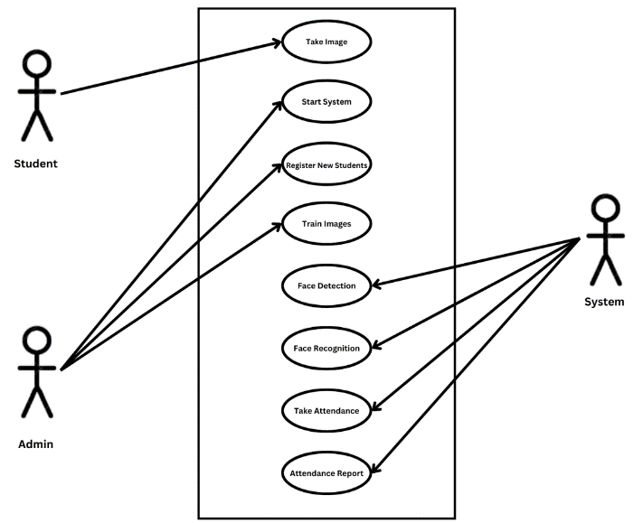
Use Case Diagram

Slide 13
Algorithm Used
Haar Cascades : Haar Cascades use Haar-like features, which are digital image features used to detect objects in an image or video.
Local Binary Pattern Histograms (LBPHs) : Local Binary Patterns (LBPs) is a simple yet very efficient texture operator which labels the pixels of an image by thresholding the neighborhood of each pixel and considers the result as a binary number. Furthermore, for some datasets, it has been found that combining LBP with the histograms of oriented gradients (HOG) descriptor significantly increases the detection performance.

Slide 14
Technologies Used
Python
OpenCV

Slide 15
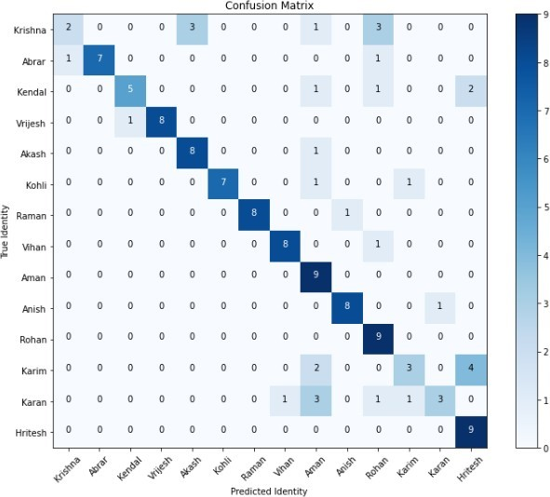
Results : (i) Confusion Matrix
Confusion Matrix

Slide 16

Results : (ii) Analysis of Performance Metrics
Analysis of Performance Metrics

Slide 17
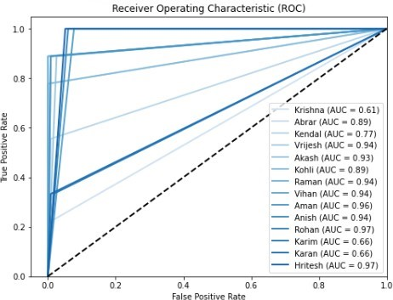
Results : (iii) Receiver Operating Characteristics (ROC) and Area Under Curve (AUC)
Receiver Operating Characteristics (ROC) and Area Under Curve (AUC)

Slide 18
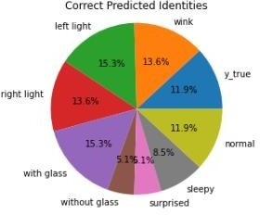
Results : (iv) Distribution of Correctly Predicted Identities
Distribution of Correctly Predicted Identities

Slide 19


Web Interface : (1) Back-end Server

Slide 20
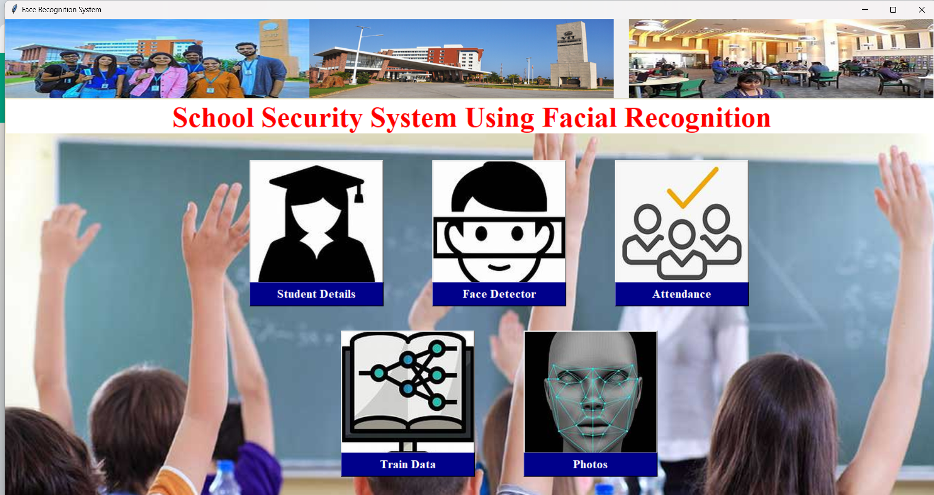
Web Interface : (2) Webapp Preview – (i) Landing Page

Slide 21
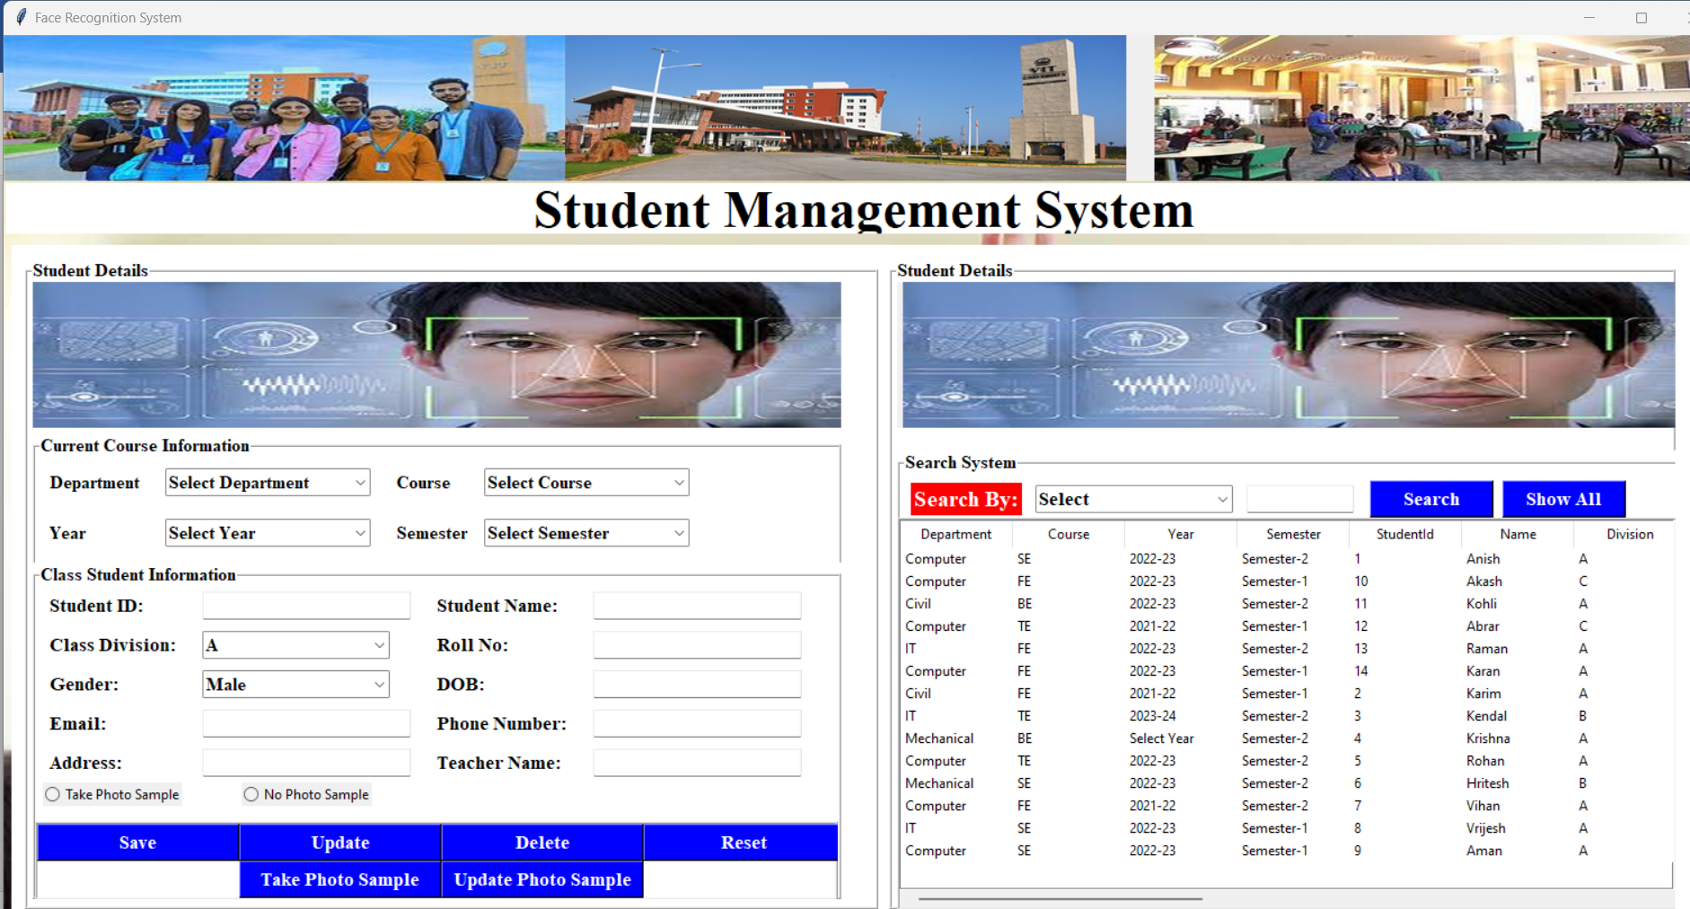
Web Interface : (2) Webapp Preview – (ii) Student Management System

Slide 22
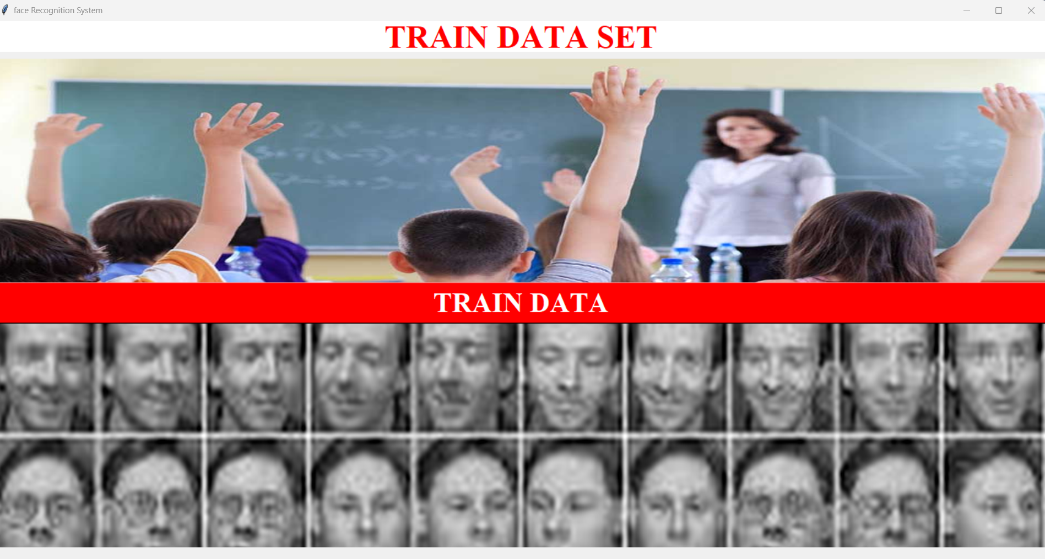
Web Interface : (2) Webapp Preview – (iii) Train Data Set

Slide 23
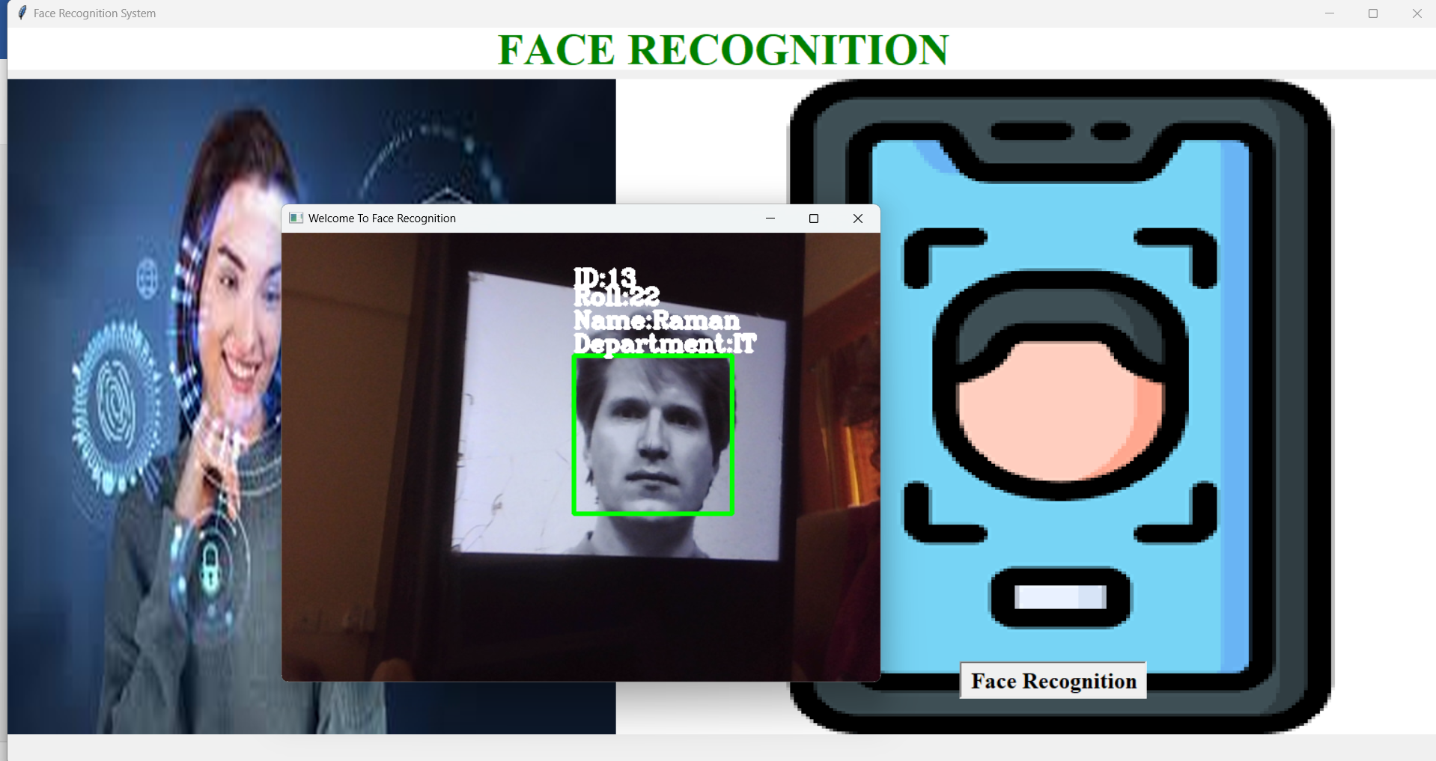
Web Interface : (2) Webapp Preview – (iv) Face Recognition

Slide 24
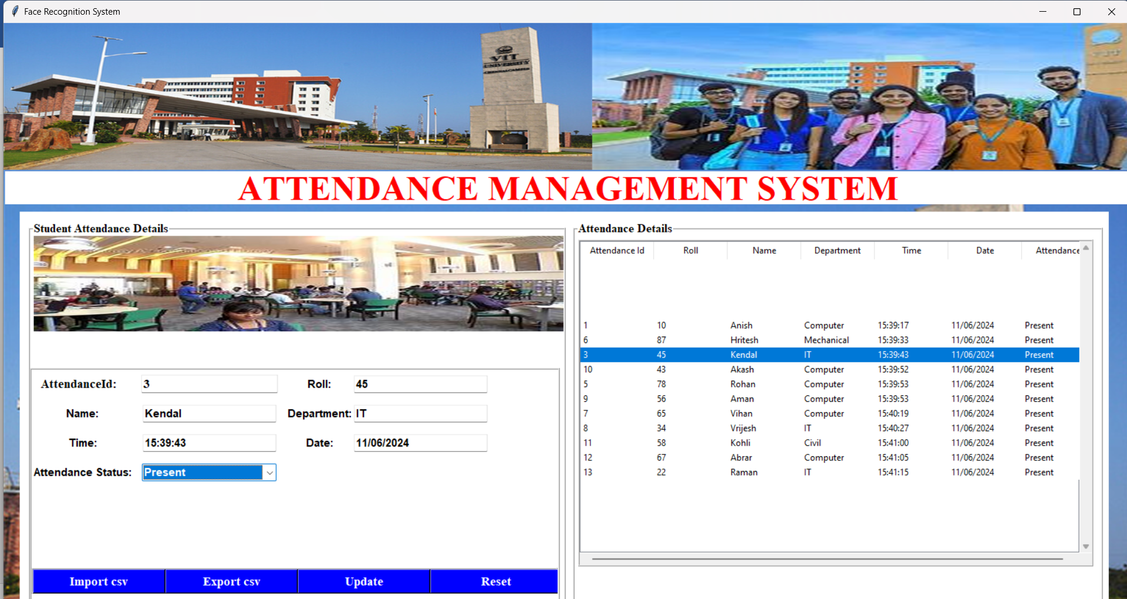
Web Interface : (2) Webapp Preview – (v) Attendance Management System

Slide 25
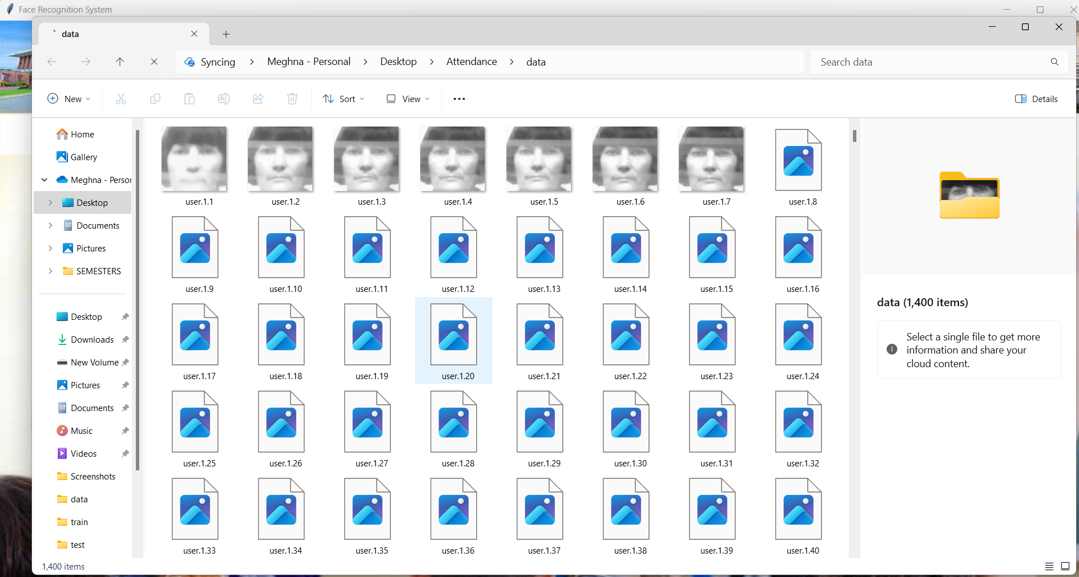
Web Interface : (2) Webapp Preview – (vi) Photos

Slide 26
Research Paper Details
Paper Title : Facial Frontiers: Unveiling the Potential of LBPHs and Haar Cascades in Facial Recognition for Enhanced School Security
Authors :
Students : Krish Goel, Meghna Das, Aastha Kumar, Godavari Tanmayi, T Suraj Kumar
Faculty Supervisor : Dr. Suganya R.
Faculty Co-Supervisor : Dr. Subbulakshmi T.
Journal Name : International Journal For Multidisciplinary Research (IJFMR)
Volume & Issue : Volume 6, Issue 4 (July-August 2024)
DOI : https://doi.org/10.36948/ijfmr.2024.v06i04.24527
Published on : 2024-07-12
Paper Link : https://www.ijfmr.com/research-paper.php?id=24527
Issue Page Link : https://www.ijfmr.com/publication-archive.php?volume=6&issue=4

Slide 27
Individual Contribution

Slide 28
Future Scope
A mobile application to make attendance data and notifications accessible from any other place will enhance mobility and accessibility.
Additional modalities can be added to the system—continuing with fingerprint or iris recognition—to provide higher security for the system and its reliability through multimodal biometric authentication.
Introduce cloud computing to make it self-scaling and more accessible.
Face mask detection can be integrated into the system to ascertain safety protocols for attendance marking procedures in a pandemic-stricken environment, like the one presently suffering from COVID-19.
Integrate IoT sensors to automate attendance marking based on physical presence at places of interest, reducing manual intervention.

Slide 29
Conclusion
The face recognition project demonstrates the practical application of computer vision and database technologies in automating attendance management.
It offers a scalable solution suitable for educational institutions, corporate offices, and public events.
By refining and optimizing the system, it can streamline attendance tracking processes, improve security measures, and enhance overall user experience.

Slide 30
THANK YOU

